Slide 1
Data Structure
Programming Project #1
郭建志

Slide 2
Background
Large-scale geographic routing
Every node only has the local information (i.e., its neighbors’ information) and the destination’s information
destination
source

Slide 3
Background
Large-scale geographic routing
Every node only has the local information (i.e., its neighbors’ information) and the destination’s information
So, how should a source route a packet to a designated destination?
destination
source

Slide 4
Naïve Routing Scheme: Greedy
Forward the packet towards the neighboring node that is closer to the destination
destination
source

Slide 5
Naïve Routing Scheme: Greedy
Forward the packet towards the neighboring node that is closer to the destination
However, the packet may be stuck at the dead end
dead end
destination
source

Slide 6
Face Routing
Generate a planar subgraph: no crossing links
Right-hand rule
Change faces
destination
source

Slide 7
Face Routing
Generate a planar subgraph: no crossing links
Right-hand rule
Change faces
face
destination
face
face
face
face
source

Slide 8
Programming Project #1: Generate a Planar Subgraph
Generate a planar subgraph: no crossing links

Slide 9
Programming Project #1: Generate a Planar Subgraph
Input file: 5 0 1.5 2.3 1 1.2 2.6 2 1.3 1.2 ...
Input:
Number of nodes
Nodes with non-negative coordinates (x, y) (the input graph is connected when we add links if dist(u,v) ≤ 1)
Procedure:
Add a link between any two nodes u, v as dist(u,v) ≤ 1
Remove some links to generate a planar graph
Output:
The edges before and after planarization
The grade is proportional to the number of remaining edges
Output file:
12 0 0 1 1 1 2 2 1 3
…
8
0 0 1
2 1 3
4 3 4

Slide 10
Programming Project #1: Generate a Planar Subgraph
Input file: 5 0 1.5 2.3 1 1.2 2.6 2 1.3 1.2 ...
Input:
Number of nodes
Nodes with non-negative coordinates (x, y) (the input graph is connected when we add links if dist(u,v) ≤ 1)
Procedure:
Add a link between any two nodes u, v as dist(u,v) ≤ 1
Remove some links to generate a planar graph
Output:
The edges before and after planarization
The grade is proportional to the number of remaining edges
Output file:
12 0 0 1 1 1 2 2 1 3
…
8
0 0 1
2 1 3
4 3 4
…

Slide 11
Programming Project #1: Generate a Planar Subgraph
Input file: 5 0 1.5 2.3 1 1.2 2.6 2 1.3 1.2 ...
Input:
Number of nodes
Nodes with non-negative coordinates (x, y) (the input graph is connected when we add links if dist(u,v) ≤ 1)
Procedure:
Add a link between any two nodes u, v as dist(u,v) ≤ 1
Remove some links to generate a planar graph
Output:
The edges before and after planarization
The grade is proportional to the number of remaining edges
Output file:
12 0 0 1 1 1 2 2 1 3
…
8
0 0 1
2 1 3
4 3 4
棄選了

Slide 12
Programming Project #1: Generate a Planar Subgraph
Input file: 5 0 1.5 2.3 1 1.2 2.6 2 1.3 1.2 ...
Input:
Number of nodes
Nodes with non-negative coordinates (x, y) (the input graph is connected when we add links if dist(u,v) ≤ 1)
Procedure:
Add a link between any two nodes u, v as dist(u,v) ≤ 1
Remove some links to generate a planar graph
Output:
The edges before and after planarization
Implement a designated algorithm to remove the links
Output file:
12 0 0 1 1 1 2 2 1 3
…
8
0 0 1
2 1 3
4 3 4

Slide 13
Programming Project #1: Generate a Planar Subgraph
Input file: node.txt 5 0 1.5 2.3 1 1.2 2.6 2 1.3 1.2 ...
Output:
The edges before and after planarization
Notice that:
The first node ID should be smaller than the second one for each link
The links should be sequentially indexed in ascending order of the first node ID
If there is a tie, the two links are indexed in ascending order of the second node ID
The IDs of remaining links after planarization should be identical to the ones before the planarization
Output file: link.txt
12 0 0 1 1 1 2 2 1 3
…
8
0 0 1
2 1 3
4 3 4

Slide 14

Programming Project #1: Generate a Planar Subgraph
Implement a designated algorithm to remove the links
Cut a link between two neighboring nodes a and b, if there is other node c is within their the closed disc, where line segment $\overline{ab}$ is a diameter

Slide 15

Why does the algorithm work?
Prove by contradiction
Assume that there is an intersection node on the segments $\overline{ab}$ and $\overline{cd}$
c
a
a
c
d
b
b
d

Slide 16
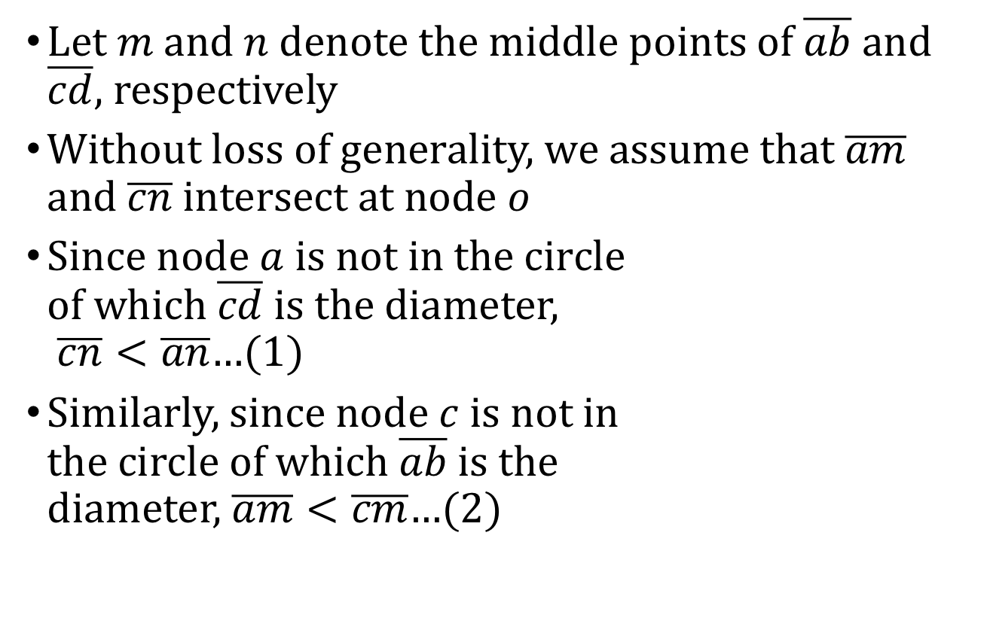
Why does the algorithm work?
Let $m$ and $n$ denote the middle points of $\overline{ab}$ and $\overline{cd}$, respectively
Without loss of generality, we assume that $\overline{am}$ and $\overline{cn}$ intersect at node $o$
Since node $a$ is not in the circle of which $\overline{cd}$ is the diameter, $\overline{cn}<\overline{an}$…(1)
Similarly, since node $c$ is not in the circle of which $\overline{ab}$ is the diameter, $\overline{am}<\overline{cm}$…(2)
c
a
o
n
m
b
d

Slide 17
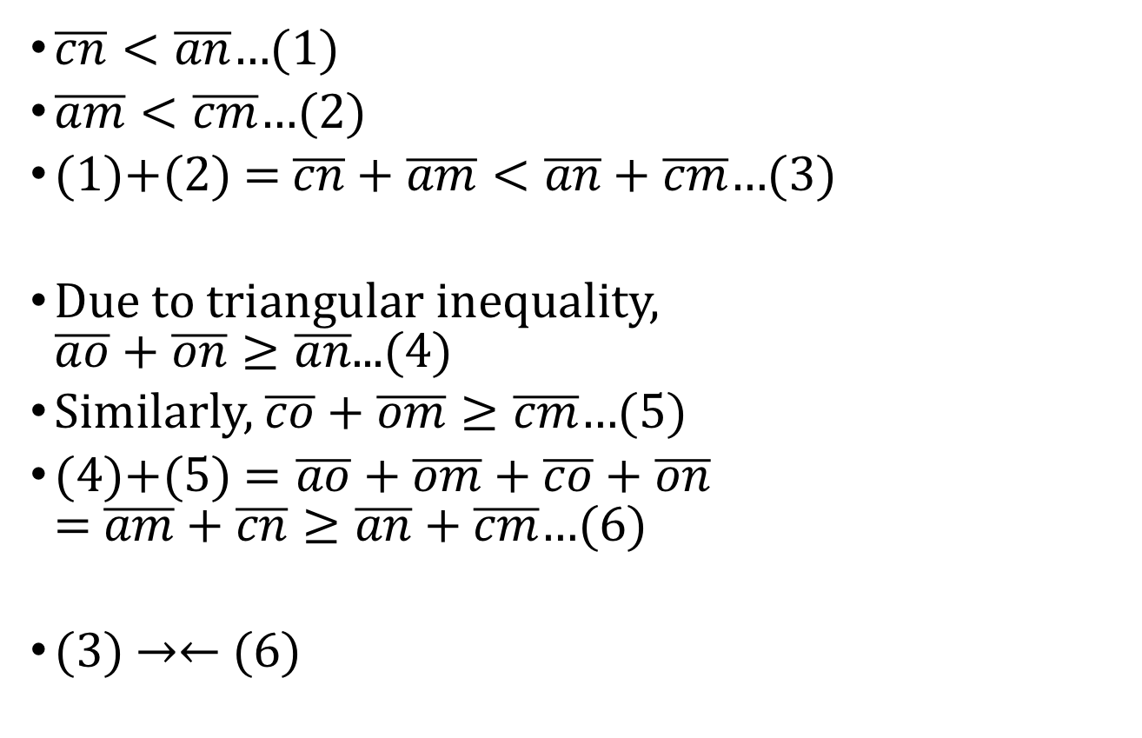
Why does the algorithm work?
$\overline{cn}<\overline{an}$…(1)
$\overline{am}<\overline{cm}$…(2)
(1)+(2) = $\overline{cn}+\overline{am}<\overline{an}+\overline{cm}$…(3)
Due to triangular inequality, $\overline{ao}+\overline{on}≥\overline{an}$...(4)
Similarly, $\overline{co}+\overline{om}≥\overline{cm}$…(5)
(4)+(5) $=\overline{ao}+\overline{om}+\overline{co}+\overline{on}$ = $\overline{am}+\overline{cn}≥\overline{an}+\overline{cm}$…(6)
(3) →← (6)
c
a
o
n
m
b
d

Slide 18
Input Sample: node.txt
11
0 1.4142 1.1534
1 1.97 1.85
2 0.8823 1.3926
3 1.9996 1.9484
4 0.6301 1.9145
5 0.3329 1.1756
6 1.952 0.5866
7 1.8181 0.4043
8 0.4949 1.946
9 0.2079 1.4758
10 0.1364 1.4084

Slide 19
Output Sample: link.txt
22
0 0 1
1 0 2
2 0 3
3 0 6
4 0 7
5 1 3
6 2 4
7 2 5
8 2 8
9 2 9
10 2 10
11 4 5
12 4 8
13 4 9
14 4 10
15 5 8
16 5 9
17 5 10
18 6 7
19 8 9
20 8 10
21 9 10
11
0 0 1
1 0 2
3 0 6
5 1 3
6 2 4
7 2 5
12 4 8
17 5 10
18 6 7
19 8 9
21 9 10

Slide 20
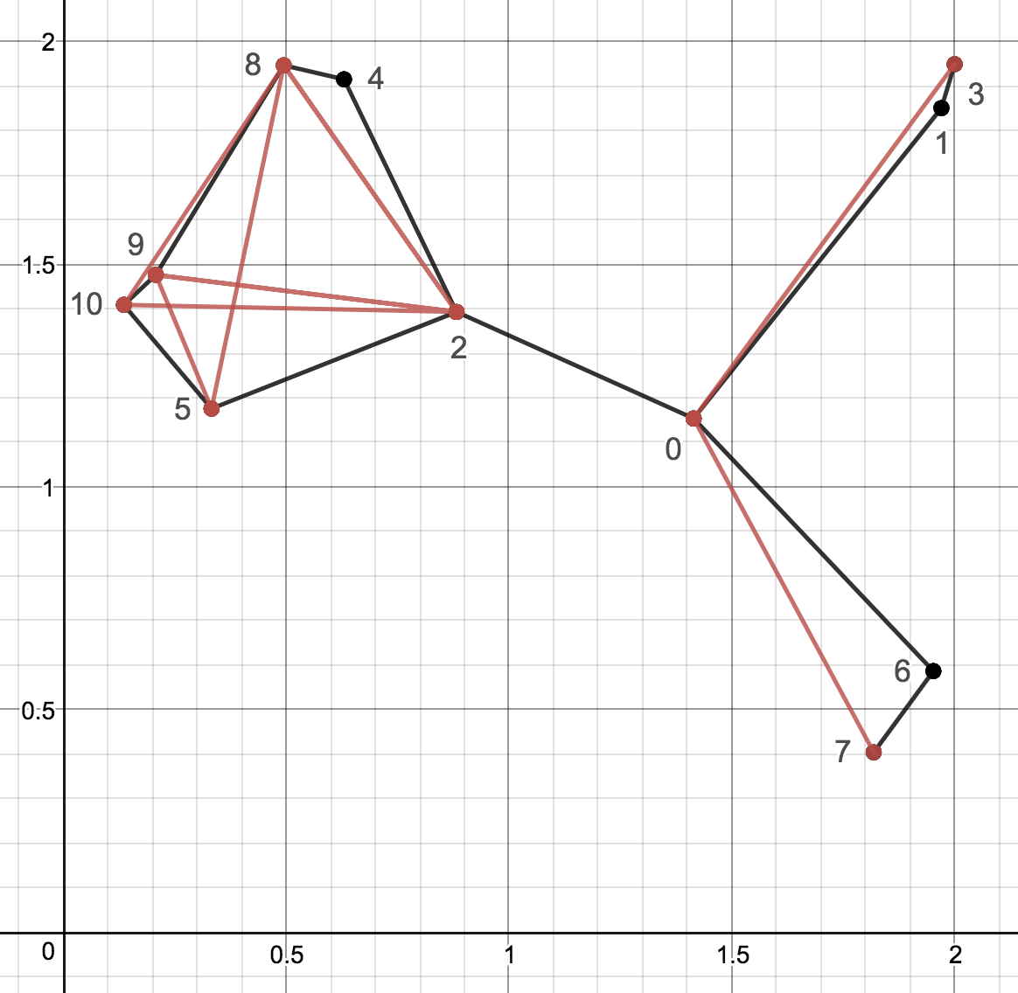
Note
Deadline: 10/11 Thu
E-course
C Source code
Readme including: brief description and time complexity analysis of you implementation

